Slide 1


Brace!
Yourselves!
Because Disasters Have No Chill (except winter storms)

Slide 2
Table of Contents
01
02
03
04
Assumptions & Facts
Disaster Impact Analysis
So...What’s the Plan?
Our Solution
Notes:
Edit font
Remove additions

Slide 3
Our Mission:
Enhancing patient assistance through optimized healthcare resources, emergency preparedness, and disaster relief. We try to ensure timely, equitable, and efficient care through strategic coordination and proactive resource allocation.

Slide 4
Problem Statement:
During times of natural disasters, patient assistance can be improved by effectively organizing available resources within a larger healthcare company and leveraging emergency preparedness and disaster relief resources.

Slide 5
Assumptions
01

Slide 6
General Assumptions
The HCA dataset represents the year 2024 – We assume that all employee data is up to date for 2024, meaning staffing levels and disaster impacts reflect current conditions.
FEMA Disaster dataset includes all federally declared disasters – The disaster dataset is assumed to capture all major disasters impacting counties where HCA operates.
Notes:
Add timeframe for fema dataset

Slide 7
Facts
01

Slide 8
HCA Employee Dataset:
  Source: Provided directly by HCA Healthcare, ensuring it accurately represents employee distribution across facilities.
  Scope: Covers over 200,000 employees, providing a comprehensive view of workforce distribution across disaster-prone regions.
  Timeframe: Assumed to reflect 2024 staffing levels, aligning with real-world disaster response planning.
Disaster Declarations Dataset:
  Source: Based on FEMA disaster declarations, which are officially recorded federal disasters.
  Scope: Includes all federally recognized disasters affecting counties where HCA operates.
  Timeframe: Includes data from 2012 to 2024
  Classification: Disaster types are categorized following FEMA’s standard classifications (hurricanes, floods, severe storms, etc.).

Slide 9
Disaster Impact Analysis
02

Slide 10
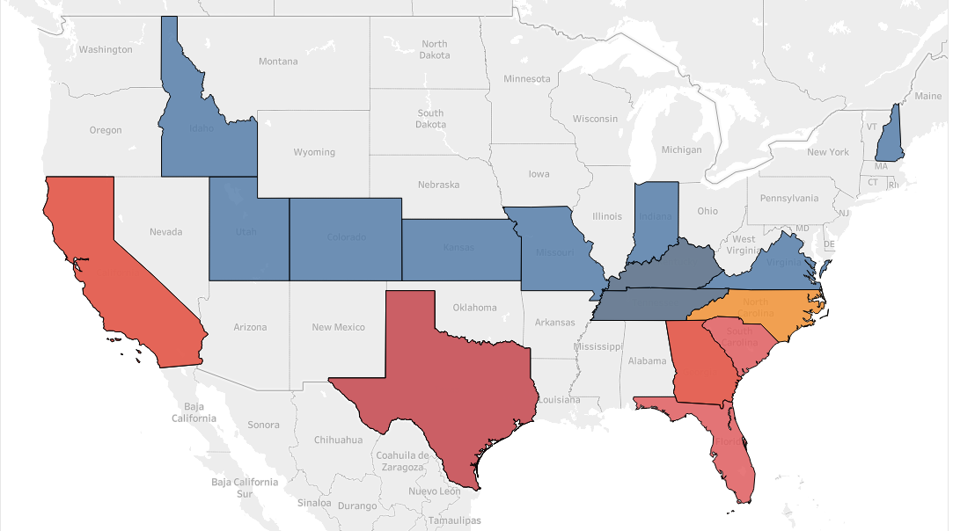
DISASTER PRONE STATES
Notes:
High Risk → Top 10% of counties with the highest disaster_count.
Medium Risk → Next 20% of counties (80th–90th percentile).
Low Risk → Remaining 70% of counties with fewer disasters.

Slide 11
RISK CATEGORIZED STATES
HIGH RISK STATES
California
Texas
Florida
South Carolina
Georgia
MEDIUM RISK STATES
North Carolina
LOW RISK
STATES
Idaho
Utah
Colorado
Kansas
Virginia
Missouri
Indiana

Slide 12
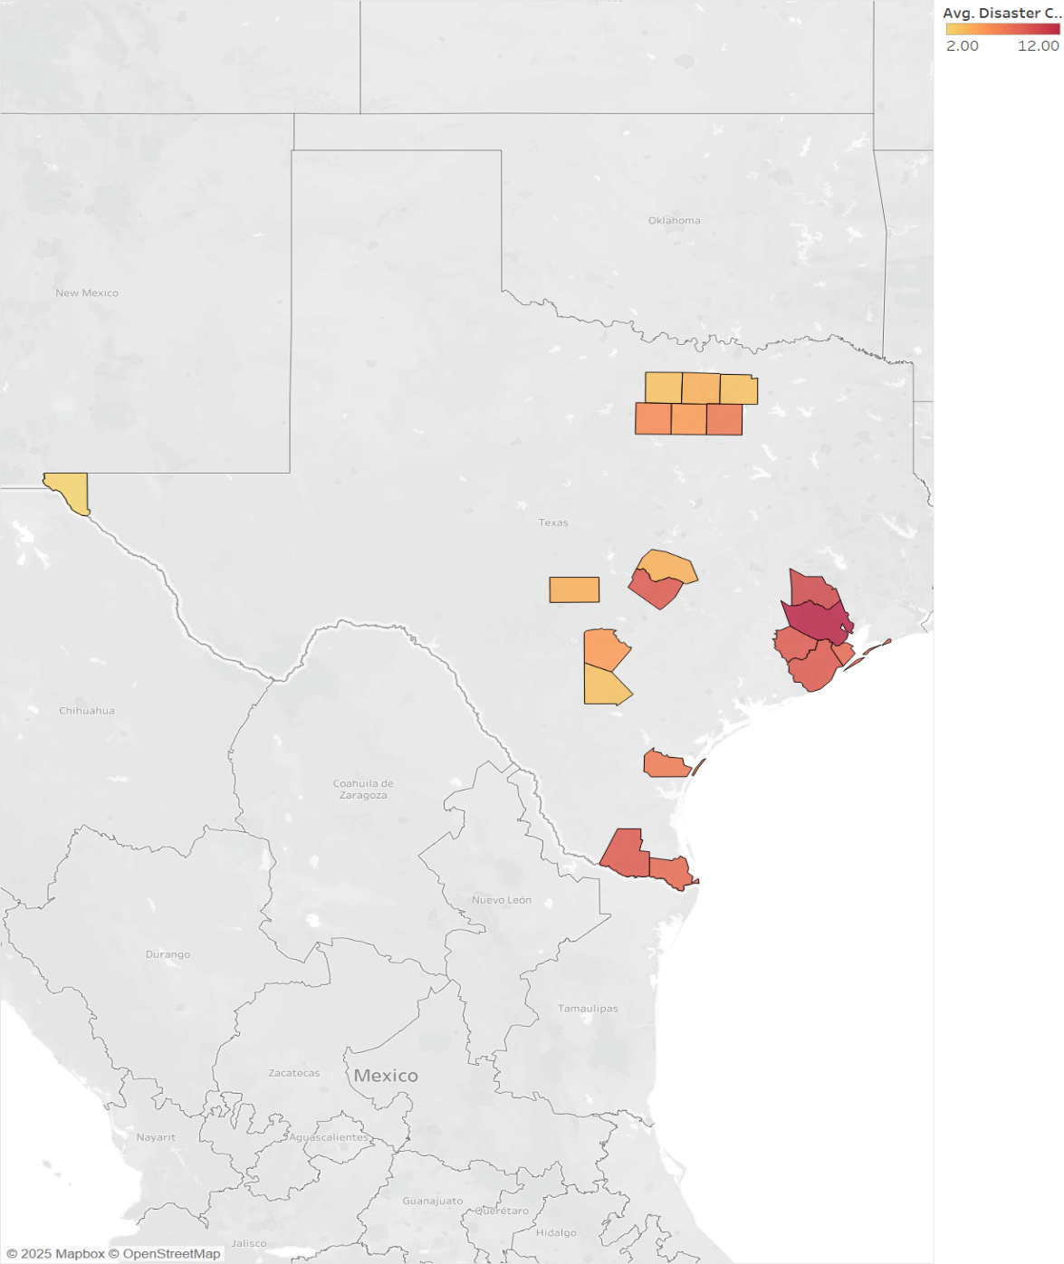
Identify high-risk counties:
Texas
Top 3 High-Risk Texas Counties by Disaster Count:
Harris (12)
Montgomery (10)
Travis (9)
Notes:
Speaker Notes: Identifying High-Risk Counties (Texas & Florida)
This map highlights counties with the highest disaster counts, using a color gradient where darker red indicates higher disaster frequency.
We focused on Texas and Florida, as these states house a large portion of HCA facilities and are frequently impacted by hurricanes, floods, and severe storms.
Key Insight: Harris, Montgomery, and Travis counties in Texas have the highest number of federally declared disasters, making them priority areas for disaster preparedness.
This visualization helps identify regions that require more resources for emergency response planning.

Slide 13
Harris
Montgomery
*Brazoria County has 607 employees, and Fort Bend has 599 employees. Same number of disasters.
Brazoria & Fort Bend
Galveston
High-risk, low-staffed counties: These counties experience frequent disasters but have fewer employees to respond effectively.
Potential workforce strain: Limited local staff could lead to shortages in emergency response and patient care.
Need for external support: These counties may rely on reinforcements from nearby regions with greater workforce availability.
Proactive resource allocation: Identifying these gaps helps ensure strategic workforce distribution and emergency preparedness.

Slide 14
So...What’s the Plan?
03

Slide 15
HCA facilities face frequent disasters, especially in Texas.
Employee distribution varies across counties, affecting disaster preparedness.
Some high-risk areas have lower workforce coverage, making response efforts difficult.
Resource allocation may not be optimized—some counties may have too few resources for their risk level.
To improve preparedness, we need a data-driven approach that aligns employee distribution with disaster risks.
Given these challenges, how do we ensure HCA is best prepared for the next disaster? That’s where our solution comes in.

Slide 16
Our Solution
04

Slide 17
We developed an interactive, data-driven approach to identify high-risk counties, assess workforce vulnerability, and guide strategic resource allocation for HCA’s disaster planning. Our analysis highlights which counties face the highest disaster impact and workforce strain, allowing decision-makers to prioritize emergency staffing and resource distribution effectively.

Slide 18
Let's understand this by getting a demo of what could be done.
Relief zones:
Primary (neighboring counties): The first line of response, handling immediate evacuations, patient transfers, and emergency care. The focus is on moving people out of the impact zone efficiently while ensuring nearby facilities can absorb the influx.
Secondary (within 150 miles): Acts as a backup support system, providing additional medical capacity, shelter, and resources if the primary zone becomes overwhelmed.
Tertiary (within 300 miles): Serves as the final reinforcement layer, deploying extra personnel, equipment, and supplies for sustained disaster response and long-term recovery.
Harris
Avg Disaster Count: 12
HCA Hospitals/Affiliates: 11
Population: ~4,835,125
Notes:
Add timeframe for fema dataset

Slide 19
The primary relief zone is the most impacted by disasters, requiring a large-scale response. Nearby counties alone may not have enough resources, making a tiered relief system essential.
A structured three-zone disaster response strategy ensures effective resource allocation:
                - Primary Zone: Neighboring counties focus on immediate evacuations and patient transfers.
              - Secondary Zone (Within 150 Miles): Provides additional medical support and workforce reinforcements.
              - Tertiary Zone (Within 300 Miles): Deploys extra personnel, equipment, and long-term recovery aid.
Population size plays a key role. Harris County’s large population demands more resources, while smaller counties can serve as supply hubs rather than evacuation centers.
A proactive, data-driven approach is needed. Regular analysis of disaster frequency, staffing levels, and logistical routes can improve real-time response and preparedness.

Slide 20
A real-time monitoring system is essential for tracking disaster frequency, employee distribution, and resource availability. Implementing a centralized dashboard will enable informed decision-making and ensure a more effective disaster response strategy.

Slide 21
Dashboard Design
Select State
Select County
Select Disaster
Select Hospital
List of Available Resources
List of Needed Resources

Slide 22
Strategic Planning for Disaster Readiness
Identifying High-Risk Counties
Why? HCA needs proactive disaster preparation for counties most at risk.
How? Using historical disaster data, we rank counties by disaster frequency and impact severity.
Outcome? HCA can preemptively allocate emergency personnel and resources to hardest-hit areas before a crisis.
Understanding Employee Exposure
Why? Disasters disrupt hospital operations, affecting thousands of employees and their ability to work.
How? We calculate an Employee-to-Disaster Ratio, showing which counties have high staff exposure to frequent disasters.
Outcome? HCA can redirect staffing efforts to ensure facilities in high-risk areas are not understaffed during critical moments.
Interactive Visualizations for Decision-Making
Why? HCA decision-makers need clear, interpretable insights without deep technical expertise.
How? We created interactive visualizations that allow users to filter and explore disaster impact, workforce distribution, and county-specific risks.
Outcome? These insights support quick, informed disaster response planning at both state and regional levels.

Slide 23
While our dataset focuses on identifying high-risk counties and workforce exposure, additional proactive solutions can enhance HCA's disaster preparedness. These solutions require external data, operational planning, and strategic investment.
Proactive Resource Allocation
Pre-Positioning Medical Supplies
Alternate Treatment Locations
Strengthening Emergency Response Logistics
Evacuation Route Optimization
Partnerships with Emergency Agencies
Facility Infrastructure and Disaster Resilience
Facility Vulnerability Audits
Backup Energy and Water Systems
Notes:
Proactive Resource Allocation
Pre-positioning medical supplies – Stockpiling essential resources in high-risk counties before disaster strikes.
Alternative treatment locations – Establishing backup facilities or using telehealth when hospitals are compromised.
Strengthening Emergency Response Logistics
Evacuation route optimization – Using GIS and traffic data to ensure fast patient transfers.
Partnerships with emergency agencies – Coordinating with FEMA and local responders for streamlined aid.
Facility Infrastructure and Disaster Resilience
Facility vulnerability audits – Identifying hospitals at high structural risk from disasters.
Backup energy and water systems – Ensuring emergency generators and satellite communication.

Slide 24
Future Scope
Update the dashboard to include data from all facilities linked or collaborating with HCA.
Ensure data is up to date and integrated with population increase/migration trends.
Develop a simple analysis for need vs. available resource allocation.
Enable quick decision-making and improve emergency preparedness.

Slide 25
Our Mission:
Enhancing patient assistance through optimized healthcare resources, emergency preparedness, and disaster relief. We ensure timely, equitable, and efficient care through strategic coordination and proactive resource allocation.

